Slide 1
DNA derived datasets
Architecture

Slide 2
DNA Derived
AVRO
Pipelines
Transforms
Extensions
Data
Beam Pipeline
Output
Transform 1
Transform 2
Transform 3
Transform
4

Slide 3
DNA derived extension
Pipelines
DWCA
Verbatim AVRO
Pipeline
Interpretation Pipeline
UUID
Pipeline
SOLR
Pipeline
SOLR
Cluster
Biocache
Service
Location Transform
Taxonomy Transform
Sensitive
Pipeline
AVRO
Index
Pipeline
Attribution Transform
Temporal Transform
Image
Pipelines
Duplicate
Detection
Pipeline
Multimedia Transform
Verbatim Transform
DNA Transform
Sampling
Pipeline
Jackknife
Pipeline
‹#›

Slide 4
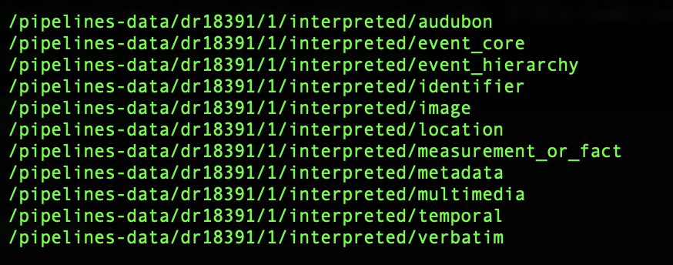
Transforms and outputs
Data resource UID
DIrectory per transform

Slide 5
Name matching - non Linnean
Pipelines
DWCA
Verbatim AVRO
Pipeline
Interpretation Pipeline
UUID
Pipeline
SOLR
Pipeline
SOLR
Cluster
Biocache
Service
Location Transform
Non-linnean
taxonomy Transform
Sensitive
Pipeline
AVRO
Index
Pipeline
Attribution Transform
Temporal Transform
Image
Pipelines
Duplicate
Detection
Pipeline
Multimedia Transform
Verbatim Transform
Sampling
Pipeline
Jackknife
Pipeline
DNA Transform
‹#›

Slide 6
Sensitive data processing
Pipelines
DWCA
Verbatim AVRO
Pipeline
Interpretation Pipeline
UUID
Pipeline
SOLR
Pipeline
SOLR
Cluster
Biocache
Service
Location Transform
Taxonomy Transform
Sensitive
Pipeline
AVRO
Index
Pipeline
Attribution Transform
Temporal Transform
Image
Pipelines
Duplicate
Detection
Pipeline
Multimedia Transform
Verbatim Transform
DNA Transform
Sampling
Pipeline
Jackknife
Pipeline
‹#›

Slide 7
Sensitive data processing
Sensitive
Pipeline
Scientiific Name: Aus bus
Coordinates: 138.1, 27.1
SDS Service
Get sensitive species
for Victoria
Species Lists
tool

